Slide 1

Exploring __shfl_down_sync
Basem Sherief zeen - 1210207
To access any code or reports used here you can refer to my github repo:
Parallel-Computing---GPU/Reduction_Sync_Warps_1 at main · BassemAdam/Parallel-Computing---GPU

Slide 2
Does Sending data from threads within same warp really matters ?
Registers
We can access this in 1 clock cycle
Shared Memory
Approx 5 clock cycles
Global Memory
And this is way more than 5 XD approx. 150 ?

Slide 3
That’s why I will do a demo in finding max and compare performance
So in theory yes it should of course matters
USUALLY we can utilize sending data within warps
If we are doing reduction
Using Shared Memory
Using Shared Memory along __shfl_down_sync

Slide 4
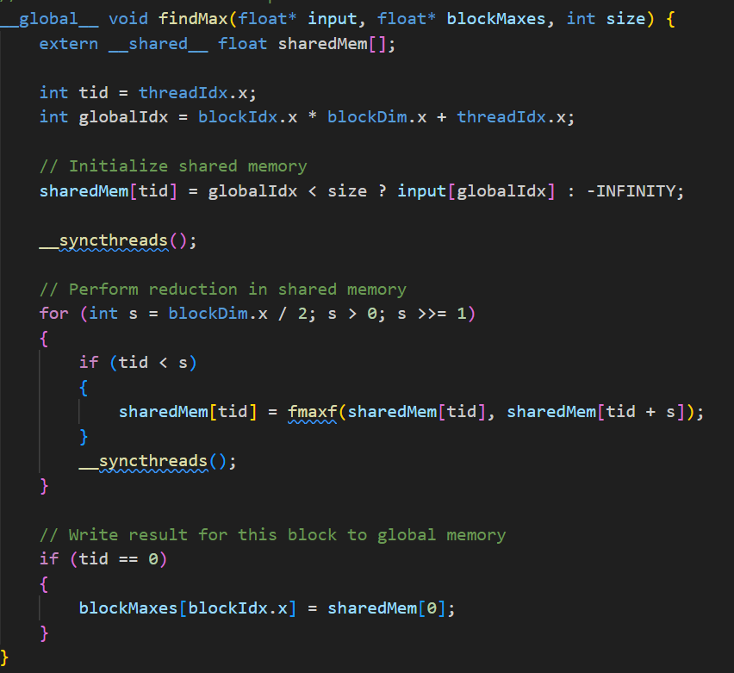
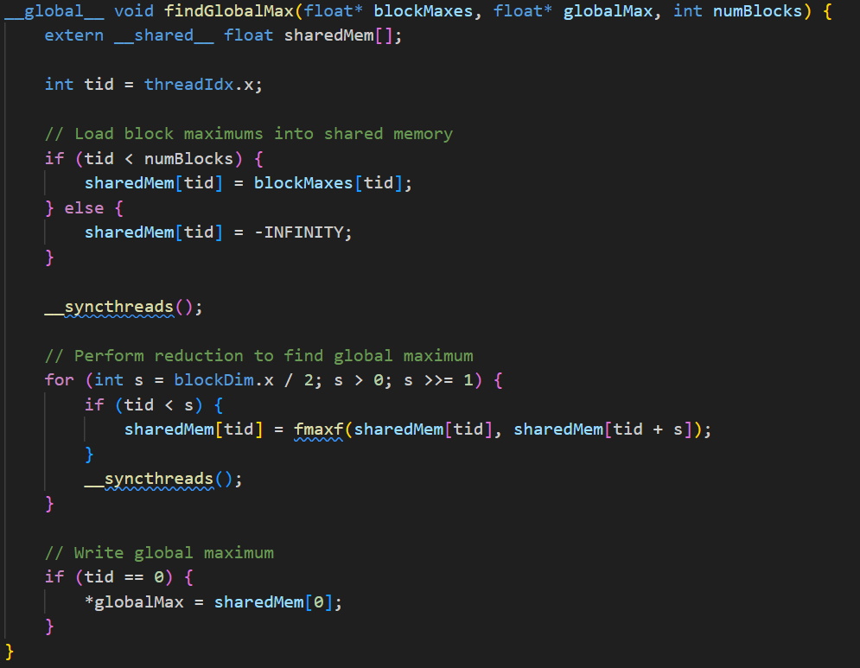
Using Shared Memory only
Finding Max per block
Finding Global Max

Slide 5
Finding Max per block
data
1
2
3
4
5
6
7
8

Slide 6
Finding Max per block
data
1
2
3
4
5
6
7
8
For this demo I will use number of threads within block equal 2 to be general case
int blockSize = 2;

Slide 7

Finding Max per block
So we will need number of blocks equal to
int gridSize = (size + blockSize - 1) / blockSize;
$$number of blocks=\frac{8+2 −1}{2}=4$$
data
1
2
3
4
5
6
7
8
0
1
2
3

Slide 8
Finding Max per block
0
1
2
3
This is global index for data
1
2
3
4
5
6
7
8
0
1
2
3

Slide 9
Finding Max per block
So now you should understand this
0
1
2
3
1
2
3
4
5
6
7
8
0
1
2
3

Slide 10

Finding Max per block
0
1
2
3
1
2
3
4
5
6
7
8
0
1
2
3
instead of loading each time from global memory we can load the data that the block will need and of course this can be calculated as block size * float
And shared memory is local for each block
That why you access it with thread
$$2 ∗float$$
Shared memory

Slide 11
Finding Max per block
Iam currently
thread 0
BLOCK 0
calling findmax
Having global index = 0
0
=
Shared memory
0
1
2
3
1
2
3
4
5
6
7
8
0
1
2
3
input

Slide 12
Finding Max per block
Iam currently
thread 0
BLOCK 0
calling findmax
Having global index = 0
0
0
=
1
Shared memory
1
2
3
2
3
4
5
6
7
8
0
1
2
3
input

Slide 13
Finding Max per block
Iam currently
thread 0
BLOCK 0
calling findmax
Having global index = 0
0
1
Shared memory
1
2
3
2
3
4
5
6
7
8
0
1
2
3
input

Slide 14
Finding Max per block
Iam currently
thread 0
BLOCK 0
calling findmax
Having global index = 0
0
Now thread waits till his friends threads inside the same block finish till this point
1
Shared memory
1
2
3
2
3
4
5
6
7
8
0
1
2
3
input

Slide 15
Finding Max per block
Iam currently
thread 1
BLOCK 0
calling findmax
Having global index = 1
1
1
=
2
Shared memory
2
3
3
4
5
6
7
8
0
1
2
3
input

Slide 16

Finding Max per block
Iam currently
thread 0
BLOCK 0
calling findmax
Back to thread 0
1
2
=
Shared memory
2
3
3
4
5
6
7
8
0
1
2
3
input

Slide 17
Finding Max per block
Iam currently
thread 0
BLOCK 0
calling findmax
Back to thread 0
S= 2/2 =1 ; s>0 ; divide by 2
1
2
Shared memory

Slide 18
Finding Max per block
Iam currently
thread 0
BLOCK 0
calling findmax
Back to thread 0
S= 1
If (0 < 1)
Compare
Sharedmem[0] and sharedmem[1]
Get max

Slide 19
Finding Max per block
Iam currently
thread 0
BLOCK 0
calling findmax
Back to thread 0
AND IF WE GENERALIZE WE WILL FIND THAT
ON ALL BLOCKS
1
2
3
4
5
6
7
8

Slide 20
Finding Max per block
Iam currently
thread 0
BLOCK 0
calling findmax
Back to thread 0
AND IF WE GENERALIZE WE WILL FIND THAT
ON ALL BLOCKS
1
2
3
4
5
6
7
8

Slide 21
Finding Max per block
Iam currently
thread 0
BLOCK 0
calling findmax
Back to thread 0
we get max per block
1
3
5
6
7
8
2
4

Slide 22
Finding Max per block
Iam currently
thread 0
BLOCK 0
calling findmax
Back to thread 0
we get max per block
1
3
5
6
7
8
And add it to blockmaxes
2
4

Slide 23
Finding Max per block
2
4
Now you reduced input to a much smaller number since you get max per block next you can
Just simply get global max in cpu or gpu
If its in gpu then you use 1 block with number of threads = grid size of the previous kernel

Slide 24
Its now turn for _shfl_down_sync
NOW WE HAVE EXPLORED THE traditional finding max
How we can do that utilizing sending data between warps ?
Literally iam having now no idea but will search and come back
Using Shared Memory
Using Shared Memory along __shfl_down_sync

Slide 25
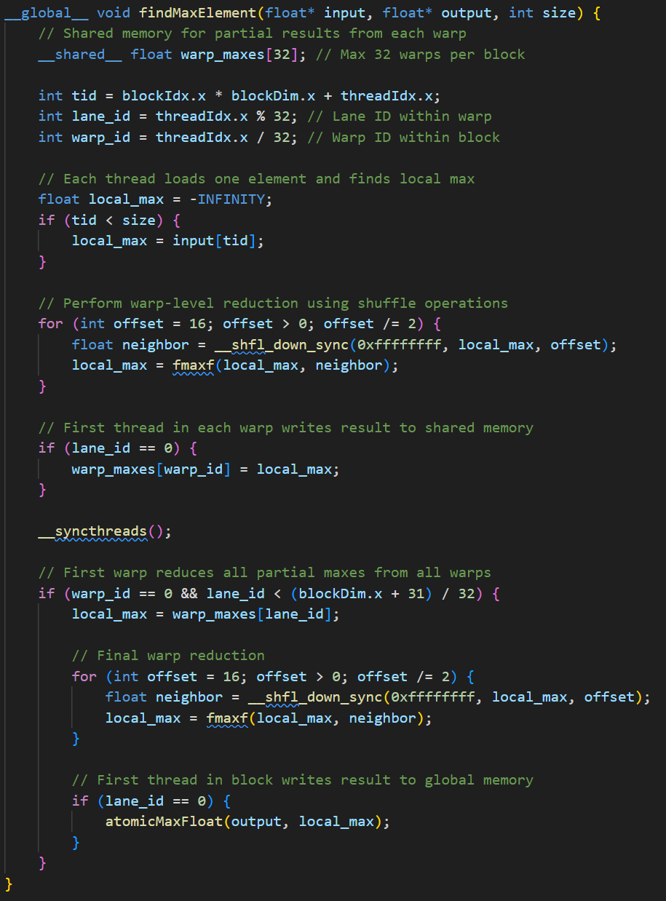
Using Shared Memory only along __shfl_down_sync
Kernel to find maximum element using warp synchronization
(iam thread 0 block 0 with blockdim = 256 this time)
Note in last example yes I used blockdim = 2 just for illustration but in code both are using the same block dim
Input DATA
1
2
3
4
5
6
7
8
32
………….
Warp_maxes
Now lets try by numbers to understand
lande_id and warp_id

Slide 26
Using Shared Memory only along __shfl_down_sync
Kernel to find maximum element using warp synchronization
(I am thread 0 block 0 with blockdim = 256 this time)
Note in last example yes I used blockdim = 2 just for illustration but in code both are using the same block dim
Input DATA
1
2
3
4
5
6
7
8
32
………….
Warp_maxes
tid | Lane_id | Warp_id
0 | 0 | 0
1 | 1 | 0
2 | 2 | 0
3 | 3 | 0
Lets try if iam other threads
Within same block

Slide 27
Using Shared Memory only along __shfl_down_sync
Kernel to find maximum element using warp synchronization
(I am thread 223 block 0 with blockdim = 256 this time)
Note in last example yes I used blockdim = 2 just for illustration but in code both are using the same block dim
Input DATA
1
2
3
4
5
6
7
8
32
………….
Warp_maxes
tid | Lane_id | Warp_id
192 | 0 | 6
193 | 1 | 6
223 | 31 | 6
224 | 0 | 7
225 | 1 | 7
226 | 2 | 7
Lets try if iam other threads
Within same block

Slide 28
Using Shared Memory only along __shfl_down_sync
Kernel to find maximum element using warp synchronization
(I am thread 223 block 0 with blockdim = 256 this time)
Note in last example yes I used blockdim = 2 just for illustration but in code both are using the same block dim
Input DATA
1
2
3
4
5
6
7
8
32
………….
Warp_maxes
So basically
And this is like assigning threads which warp do they belong to
tid | Lane_id | Warp_id
192 | 0 | 6
193 | 1 | 6
223 | 31 | 6
224 | 0 | 7
225 | 1 | 7
226 | 2 | 7
this is to divide the threads and index it locally within warps

Slide 29
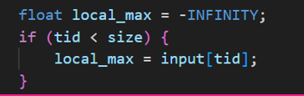
Using Shared Memory only along __shfl_down_sync
Kernel to find maximum element using warp synchronization
(I am thread 223 block 0 with blockdim = 256 this time)
Note in last example yes I used blockdim = 2 just for illustration but in code both are using the same block dim
Input DATA
1
2
3
4
5
6
7
8
32
………….
Warp_maxes
tid | Lane_id | Warp_id
192 | 0 | 6
193 | 1 | 6
223 | 31 | 6
224 | 0 | 7
225 | 1 | 7
226 | 2 | 7
but we don’t need all this threads we are barely having size of 8 , 8 elements as input
That why we check if thread id less than size

Slide 30
Using Shared Memory only along __shfl_down_sync
Kernel to find maximum element using warp synchronization
(I am thread 223 block 0 with blockdim = 256 this time)
Note in last example yes I used blockdim = 2 just for illustration but in code both are using the same block dim
Input DATA
1
2
3
4
5
6
7
8
32
………….
Warp_maxes
tid | Lane_id | Warp_id
192 | 0 | 6
193 | 1 | 6
223 | 31 | 6
224 | 0 | 7
225 | 1 | 7
226 | 2 | 7
And then make every thread to load one element from input
Reminds me of input tiling

Slide 31
Using Shared Memory only along __shfl_down_sync
Kernel to find maximum element using warp synchronization
(I am thread 223 block 0 with blockdim = 256 this time)
Note in last example yes I used blockdim = 2 just for illustration but in code both are using the same block dim
Input DATA
1
2
3
4
5
6
7
8
32
………….
Warp_maxes
tid | Lane_id | Warp_id
192 | 0 | 6
193 | 1 | 6
223 | 31 | 6
224 | 0 | 7
225 | 1 | 7
226 | 2 | 7
And then make every thread to load one element from input
Reminds me of input tiling

Slide 32
Using Shared Memory only along __shfl_down_sync
Kernel to find maximum element using warp synchronization
(I am thread 0 block 0 with blockdim = 256 this time)
Note in last example yes I used blockdim = 2 just for illustration but in code both are using the same block dim
Variables local_max
1
2
3
4
5
6
7
8
tid | Lane_id | Warp_id
192 | 0 | 6
193 | 1 | 6
223 | 31 | 6
224 | 0 | 7
225 | 1 | 7
226 | 2 | 7
And then make every thread to load one element from input
Reminds me of input tiling

Slide 33
Using Shared Memory only along __shfl_down_sync
Kernel to find maximum element using warp synchronization
Variables within warp
1
2
3
4
5
6
7
8
Tid 0
Tid 7
local_max var in findMaxElement
Thread 0 block 0 call
local_max var in findMaxElement
Thread 7 block 0 call
tid | Lane_id | Warp_id
0 | 0 | 0
1 | 1 | 0
2 | 2 | 0
4 | 4 | 0

Slide 34
Using Shared Memory only along __shfl_down_sync
Kernel to find maximum element using warp synchronization
Variables within warp
1
2
3
4
5
6
7
8
Tid 0
Tid 7
local_max var in findMaxElement
Thread 0 block 0 call
local_max var in findMaxElement
Thread 7 block 0 call
mask (usually 0xffffffff):
A bitmask indicating which threads in the warp are active.
0xffffffff = all 32 threads active. 4*8 hexa decimal = 32
so every bit determines which is active
tid | Lane_id | Warp_id
0 | 0 | 0
1 | 1 | 0
2 | 2 | 0
4 | 4 | 0

Slide 35
Using Shared Memory only along __shfl_down_sync
Kernel to find maximum element using warp synchronization
Variables within warp
1
2
3
4
5
6
7
8
Tid 0
Tid 7
local_max var in findMaxElement
Thread 0 block 0 call
local_max var in findMaxElement
Thread 7 block 0 call
var:
The value you want to shuffle from the current thread.
tid | Lane_id | Warp_id
0 | 0 | 0
1 | 1 | 0
2 | 2 | 0
4 | 4 | 0

Slide 36
Using Shared Memory only along __shfl_down_sync
Kernel to find maximum element using warp synchronization
Variables within warp
1
2
3
4
5
6
7
8
Tid 0
Tid 7
local_max var in findMaxElement
Thread 0 block 0 call
local_max var in findMaxElement
Thread 7 block 0 call
offset:
How many lanes down to move within the warp.
E.g., offset=1 → thread 0 gets value from thread 1.
tid | Lane_id | Warp_id
0 | 0 | 0
1 | 1 | 0
2 | 2 | 0
4 | 4 | 0

Slide 37
Using Shared Memory only along __shfl_down_sync
Kernel to find maximum element using warp synchronization
Variables within warp
1
2
3
4
5
6
7
8
Tid 0
Tid 7
local_max var in findMaxElement
Thread 0 block 0 call
local_max var in findMaxElement
Thread 7 block 0 call
So if the offset is 16 or 8 and
we just have 8 threads within
Warp
What will happen ?
tid | Lane_id | Warp_id
0 | 0 | 0
1 | 1 | 0
2 | 2 | 0
4 | 4 | 0

Slide 38
Using Shared Memory only along __shfl_down_sync
Kernel to find maximum element using warp synchronization
Variables within warp
1
2
3
4
5
6
7
8
Tid 0
Tid 7
local_max var in findMaxElement
Thread 0 block 0 call
local_max var in findMaxElement
Thread 7 block 0 call
So if the offset is 16 or 8 and
we just have 8 threads within
Warp
What will happen ?
tid | Lane_id | Warp_id
0 | 0 | 0
1 | 1 | 0
2 | 2 | 0
4 | 4 | 0
Lets say thread 7 is the one calling it
and shuffling down
Its local max to (7-16 =-9) thread within warp
Which does not exist
So this will not cause problem for the logic
However is there inefficiencies behind it ??
That’s depends on the implementation of shuffle I think

Slide 39
Using Shared Memory only along __shfl_down_sync
Kernel to find maximum element using warp synchronization
Variables within warp
1
2
3
4
5
6
7
8
Tid 0
Tid 7
local_max var in findMaxElement
Thread 0 block 0 call
local_max var in findMaxElement
Thread 7 block 0 call
So the actual reduction starts with offset = 4
tid | Lane_id | Warp_id
0 | 0 | 0
1 | 1 | 0
2 | 2 | 0
4 | 4 | 0

Slide 40
Using Shared Memory only along __shfl_down_sync
Kernel to find maximum element using warp synchronization
So the actual reduction starts with offset = 4
Variables within warp
1
2
3
4
5
6
7
8
tid | Lane_id | Warp_id
0 | 0 | 0
1 | 1 | 0
2 | 2 | 0
4 | 4 | 0
Tid 0
Tid 7

Slide 41
Using Shared Memory only along __shfl_down_sync
Kernel to find maximum element using warp synchronization
So the actual reduction starts with offset = 4
Variables within warp
1
2
3
4
5
6
7
8
tid | Lane_id | Warp_id
0 | 0 | 0
1 | 1 | 0
2 | 2 | 0
4 | 4 | 0
Tid 0
Tid 7

Slide 42
Using Shared Memory only along __shfl_down_sync
Kernel to find maximum element using warp synchronization
offset = 4
Tid 0
1
Local_max = max(5,1) = 5
2
3
4
5
tid | Lane_id | Warp_id
0 | 0 | 0
1 | 1 | 0
2 | 2 | 0
4 | 4 | 0
6
7
Tid 7
8

Slide 43
Using Shared Memory only along __shfl_down_sync
Kernel to find maximum element using warp synchronization
offset = 4
Tid 0
1
Local_max = max(5,1) = 5
2
Local_max = max(6,2) = 6
3
Local_max = max(7,3) = 7
4
Local_max = max(8,4) = 8
5
tid | Lane_id | Warp_id
0 | 0 | 0
1 | 1 | 0
2 | 2 | 0
4 | 4 | 0
6
7
Tid 7
8

Slide 44
Using Shared Memory only along __shfl_down_sync
Kernel to find maximum element using warp synchronization
offset = 4
Tid 0
1
Local_max = max(5,1) = 5
2
Local_max = max(6,2) = 6
3
Local_max = max(7,3) = 7
4
Local_max = max(8,4) = 8
5
tid | Lane_id | Warp_id
0 | 0 | 0
1 | 1 | 0
2 | 2 | 0
4 | 4 | 0
6
7
Tid 7
8

Slide 45
Using Shared Memory only along __shfl_down_sync
Kernel to find maximum element using warp synchronization
offset = 2
Variables within warp
5
6
7
8
Tid 0
Tid 3
tid | Lane_id | Warp_id
0 | 0 | 0
1 | 1 | 0
2 | 2 | 0
4 | 4 | 0

Slide 46
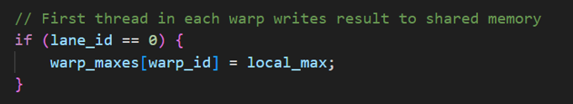
Using Shared Memory only along __shfl_down_sync
Kernel to find maximum element using warp synchronization
offset = 2
Variables within warp
5
6
7
8
Tid 0
Tid 3
And repeat the same thing over and over
You got the idea !
tid | Lane_id | Warp_id
0 | 0 | 0
1 | 1 | 0
2 | 2 | 0
4 | 4 | 0
So where is the global max within warp now ended up ?
Yes at the first lane within warp
32
8
………….
Warp_maxes

Slide 47
Using Shared Memory only along __shfl_down_sync
Kernel to find maximum element using warp synchronization
Then we wait for all threads in different warps
Within block to write its warp max
32
8
………….
Warp_maxes

Slide 48
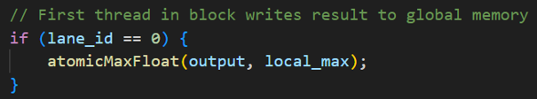
Using Shared Memory only along __shfl_down_sync
Kernel to find maximum element using warp synchronization
Then we wait for all threads in different warps
Within block to write its warp max
32
8
………….
Warp_maxes
Then we let the first warp to handle warp_maxes
And do the same thing we did above again
BUT Why this time we need atomic operation ??

Slide 49
Using Shared Memory only along __shfl_down_sync
Kernel to find maximum element using warp synchronization
Then we wait for all threads in different warps
Within block to write its warp max
32
8
………….
Warp_maxes
BUT Why this time we need atomic operation ??
Or why we didn’t need atomic operation above ?
Above we were writing to warp maxes which was shared memory within block
But now we are writing to the output which is shared along all different blocks that’s why this time we need atomic operation
And to compare between coming value and existing value max

Slide 50
So which one is really better ?

Slide 51
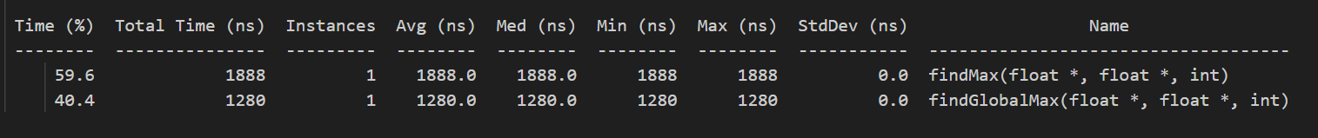
Analytics which one is really better and is it noticeable ??
Using Shared Memory
This is sequencial so total time taken is 3168
Using Shared Memory along __shfl_down_sync
So yes it was better relatively for input data size of 1000 elements
31 % reduction in total time of using shared memory only
There are also more analytics that can be done to determine if this is really better
Work efficiency
HW RESOURCES but this may be valid if we are comparing cpu with gpu ? idk
But I wont cover that here iam tired
To access any code or reports you can refer to my github repo:
Parallel-Computing---GPU/Reduction_Sync_Warps_1 at main · BassemAdam/Parallel-Computing---GPU

Slide 52
We gave a demo for shuffle down -> which is moves value from higher lane to lower one

Slide 53
Shuffle up is like shuffle down but the opposite moves a value from lower lane to a higher one
Used for: prefix sums, scanning, propagating values upstream.

Slide 54
THANK YOU

